Slide 1
Making biodiversity matter
Knowledge and know-how for the post-2020 global biodiversity framework
The outcomes of the ninth Trondheim Conference on Biodiversity, held in Trondheim, Norway, 2 – 5 July 2019
Presented by Andreas B. Schei, senior adviser in the Norwegian Environment Agency and member of the Norwegian delegation to OEWG-1
Notes:
Yesterday we’ve heard mention of the Trondheim Conference as a global consultation event which has formed part of the process leading up to the start of the OEWG process.
It was indeed the intention behind the ninth Trondheim Conference to contribute to this process, and I’ve been asked to share with you some of the outcomes of the conference with this workshop, with a specific focus on what Trondheim participants said on vision, mission, various structural elements of the framework.
All of this is based on the conference report, which can be found on the Trondheim Conference web site, and which is also an information document for this workshop.

Slide 2
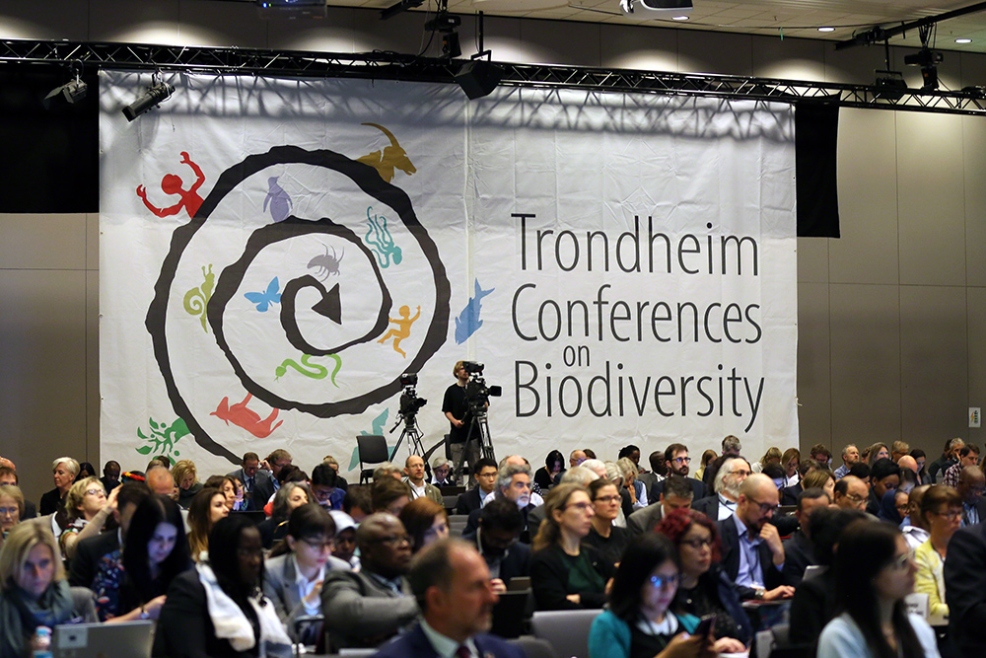
Conference focus
Notes:
The Norwegian Environment Agency has been hosting the Trondheim Conference since 1993. Since the beginning, the intention of the conference has been to provide input to the CBD with discussion and development of its scientific basis. Equally important has been to invite all countries to build competence on the subject and have an arena for open dialogue, and to help create a level playing field for all countries in CBD processes.
In line with the principles and objectives of the Trondheim Conferences, we had two main goals for the ninth conference.
Understanding some of the latest available knowledge relevant to biodiversity and ecosystem functions and services
Considering implications of this knowledge for development of the post-2020 global biodiversity framework
In the course of the four days of the ninth Conference , we had the chance to witness how the process towards a new global biodiversity framework was drawing great attention from countries, decision-makers and other sectors, as well as the and possibly unprecedented interest from the public in the crisis of biodiversity loss and what we can do to change the current trends.

Slide 3
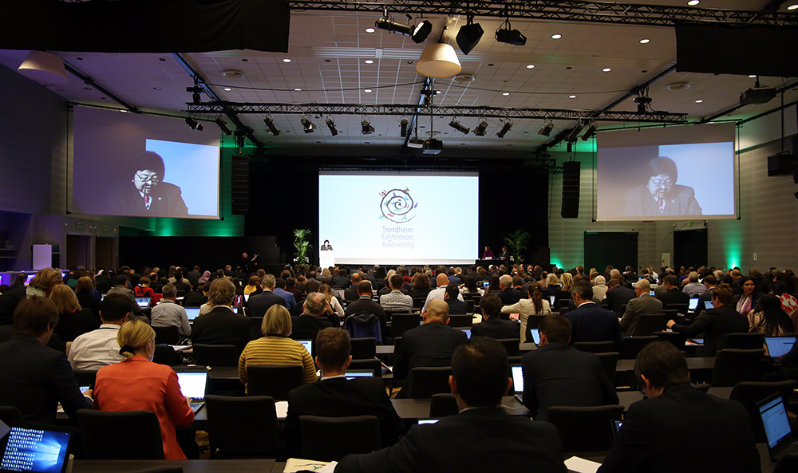
Participation
Notes:
This attention has been reflected in the Conference itself, which had well over 400 participants from almost 120 countries, which is a record high number of participants.
Participants came from governments of the CBD parties, but also from IPLCs, UN entities, international organizations, NGOs, private sector, youth and academia.
The key aim was to encourage knowledge sharing and discussion amongst participants.
There was also a strong focus on interactive sessions – with the aim of building knowledge and resources valuable for the post-2020 process
------
Background only: The conference programme encouraged participation through:
plenary presentations and discussion
moderated panel discussions
roundtable discussions
open space agenda
online and interactive polls
communal meals and social events
live streaming

Slide 4
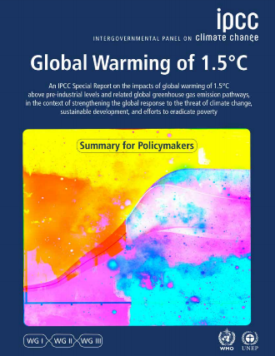
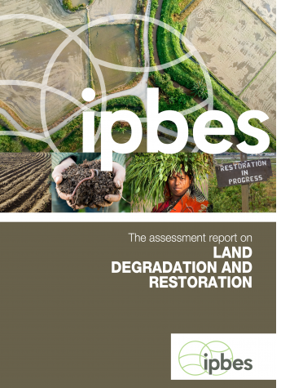
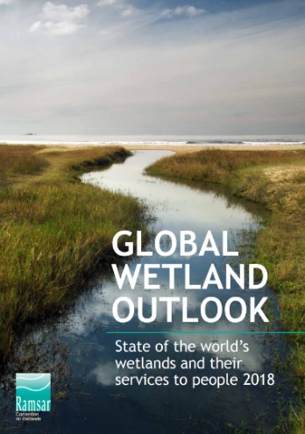
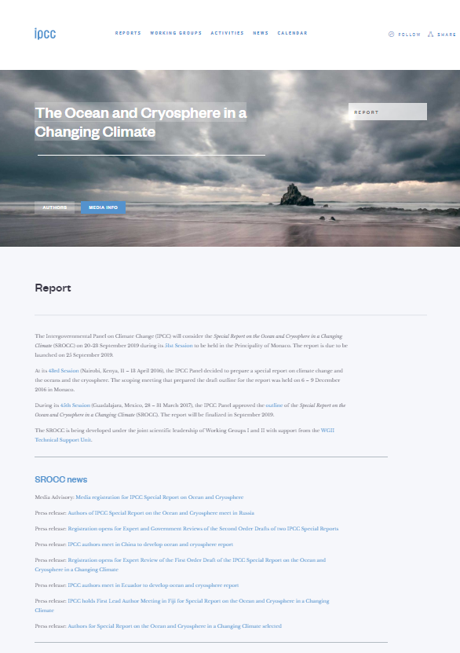
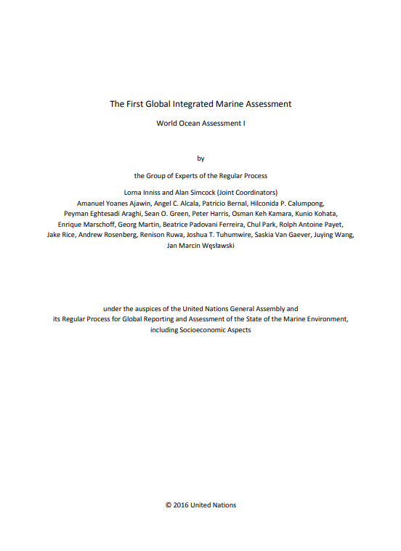
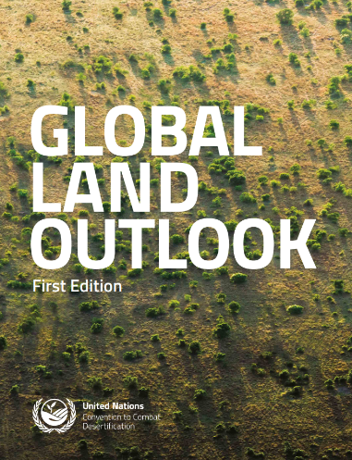
Setting the stage
Notes:
We heard throughout the Conference that the number of published scientific papers on biodiversity is increasing rapidly.
We heard presentations from a wide range of assessments, such as IPBES global assessment, IPCC 1.5 degrees report, The Global Resources Outlook from the International Resource Panel, State of the World’s Biodiversity for Food and Agriculture from FAO and The World Ocean Assessment.
There is a good knowledge base on which to build, both from science and the wealth of experiences that we have in addressing the Aichi Biodiversity Targets
All in all this wealth of documentation demonstrates that there are indeed grave concerns, but also that there are recommendations and options for action.

Slide 5
Understanding where we are heading
and what this implies
There are very real concerns over the impacts of loss of biodiversity, and such concerns are increasing
The cost of inaction makes biodiversity loss an issue of importance to all sectors and stakeholders
There is a range of options already available for implementing sustainable pathways to achieving the 2050 Vision
Understanding interlinkages is critical to being able to respond to environmental change
There is an increasing recognition of the importance of “nature-based solutions” that address needs across sectors
Notes:
Scientist are indeed warning that we are heading for fundamental change in Earth systems as a result of changes in the Biosphere.
This understanding is becoming more and more central to the global debate.
These options variously involve addressing root causes of nature deterioration and fostering transformative change.
Biodiversity goals can go hand in hand with achieving other goals, such as efforts to reduce global warming, but an integrated approach with safeguards is needed.

Slide 6
Moving away from business as usual
Important to think about biodiversity as a solution, rather than to only focus on biodiversity loss
Sustainability rests on environmental, social and economic pillars, and is not simply an ecological issue
Important to find the levers for change for taking positive and reducing negative action
Workable solutions are required that meet multiple aims, recognising and involving key players and building partnerships for addressing shared solutions
There are already examples of actions planned and taken at all levels to try to move away from ‘business as usual
Notes:
There have been frequent calls for transformative change to address previous lack of progress. Participants were asked to consider the conference as a transformative space, helping them to conceptualize change and disruption that would be part of transformative change.
These insights:
Food can be an entry point for discussion, as anybody can understand and engage, and conversations can be opened on sustainability, water and land use, biodiversity and climate.
This can be a process, such as redirecting perverse incentives to ones that are positive for biodiversity and ecosystem functions
We need to find ways to scale up more effectively. This includes cross-sectoral engagement.
There are already examples of actions planned and taken at all levels to try to move away from ‘business as usual.
Important examples that came up in Trondheim included:
Change through mainstreaming, as already embraced by CBD parties
Restoration is already being promoted, and this will be scaled up with the UN Decade on ecosystem restoration 2021-2030
Nature-based solutions are being increasingly promoted for actions addressing multiple agendas
Initiatives and increasing interest from business and the private sector, to reverse the loss of biodiversity and reduce environmental impact

Slide 7
Responding to society needs
There is willingness across all conventions to engage and to be mutually supportive in the context of their mandates
There is need to increase coherence in implementation of the Rio Conventions at the national level
Perceptions on environment-related risks have increased significantly in recent years, influencing the way in which governments and the private sector think
As business sees it, current approaches are not delivering global sustainability, and something extra is required fast.
Interlinkages with planning and strategies in other sectors need to be addressed
Notes:
There have been repeated calls for the post-2020 global biodiversity framework to provide aholistic framing of biodiversity-related goals, targets and/or milestones, responding to broader economic and societal needs. There is therefore a need to consider how diverse stakeholder actions could help build greater ambition and how this could be promoted by the post-2020 framework.
As has been mentioned here,
Each year the World Economic Forum publishes a Global Risks Report that is based on the perception of global risk amongst decision makers across sectors. In 2019 five of the eight top risks in terms of both impact and likelihood include environmental risks.
Traditional approaches are seen as being inflexible, incremental and irrelevant, suggesting a move to something innovative and impact-led. A move from a “project mentality” to a “platform mentality” is suggested.
The IPCC are working on reports with direct relevance to biodiversity, SAICM are working on their post-2020 strategy. There are opportunities for ensuring alignment.

Slide 8
Promoting and facilitation action
The focus of the conference was on the knowledge base for developing the post-2020 global biodiversity framework
However, a constant message was the critical need for capacity and resources without which success is compromised
Significant effort will need to be put into resource mobilization from all sources, recognising fully the real values of biodiversity and ecosystem services
Enhanced capacity will be needed to address the growing problems and at the same time scale up existing good practice
Notes:
When the post-2020 global biodiversity framework is adopted in 2020, parties to the Convention will also be considering the means for promoting and facilitating action. Putting in place the necessary enabling activities – resource mobilization, capacity building, technology transfer, technical and scientific cooperation – will be essential.
While I don’t have a separate slide on this, I would also like to point out two points that are related to the heading “Building on the experience since COP10 in Nagoya” in the conference report:
It is essential to be able to track implementation of the post-2020 global biodiversity framework from day one
Addressing equity and imbalances will be critical to a successful post-2020 global biodiversity framework

Slide 9
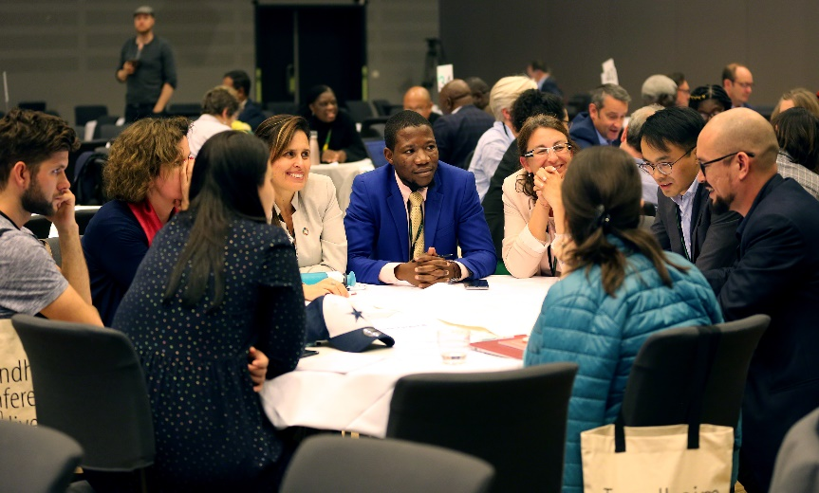
further developing the vision of where we need to be
Notes:
The first interactive session focused on the 2050 Vision for Biodiversity of “Living in harmony with nature”
Here we encouraged participants to consider the future that they want to see, and the changes necessary to achieve this

Slide 10
further developing the vision of where we need to be
Possible pathways were clustered under the following headings:
Educate, communicate Change human behaviour, perceptions, commitment Change food systems Increased participation and ownership Increased knowledge Rights, including human rights Transition into green economy and technological development Valuation, risk-assessment, accounting Local level/IPLCs Change production and consumption | Mainstreaming Human well-being Fair and equitable sharing Transformative change Sustainable use and nature management Governance, policy and legal frameworks and financial resources Monitoring, reporting, compliance Lessons learned and solutions
Notes:
Participants identified a broad range of possible pathways, showing a multifaceted and interlinked the approach to 2050 (Annex 1 of the report)
There is a wealth of keywords and ideas contained in the report on each of these headings, suggesting that active participation took place among participants from all regions and categories.
Participants wrote short stories to describe one potential pathway for achieving the 2050 vision (Annex 2 of the report)

Slide 11
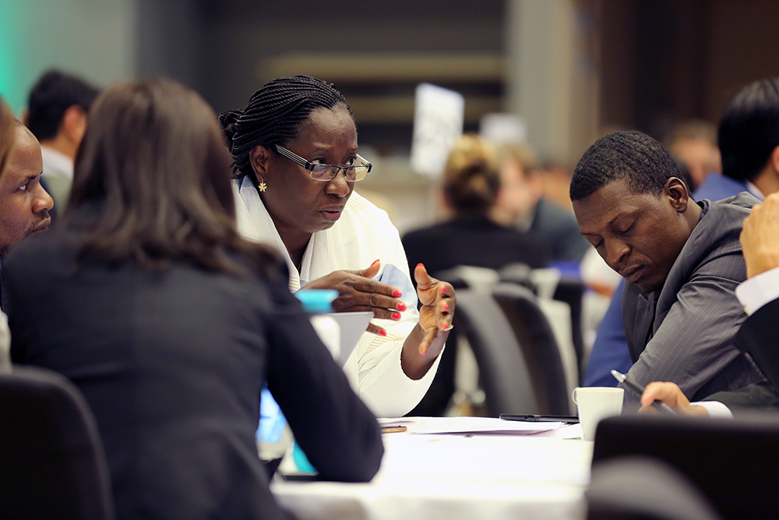
Identifying what is needed to achieve
the 2050 vision for biodiversity
Notes:
The third interactive session focused on what needs to be included in the post-2020 global biodiversity framework to deliver the 2050 Vision
Participants considered in more detail a range of elements that could be included in the post-2020 framework
Outcomes of the discussions can all be found in Annex 5 of the report.
I will present some highlights here, that I think are of particular relevance to this meeting.

Slide 12
Identifying what is needed to achieve the 2050 vision for biodiversity
The discussions covered:
Vision and mission Review and accountability Implementation/enabling Integrating agendas Structure | Target(s) for consumption and production patterns Target(s) for mainstreaming Target(s) for sustainable use Target(s) for food and agriculture Target(s) for protected areas
Notes:
This can be found comprehensively documented in the report. Even more material is available on our website.
The ideas and suggestions presented here are taken from the input received by different participants and participant groups in the interactive sessions of the conference. I present them as documentation of the creation and exchange of ideas in the conference. They have been selected as salient examples, of course with no particular recommendation in mind.

Slide 13
Identifying what is needed to achieve the 2050 vision for biodiversity
Results from the discussions – Vision and mission
Nature is what makes our lives on Earth possible
Reconnect people and nature
Connect nature to health
Nature based solutions for human needs
Inclusive and holistic approach needed
Need engagement of stakeholders
Communication and language
Recognize indigenous culture and knowledge
Capture variety of ways of understanding nature
2050 Vision remains relevant – but needs to be adaptable!
Notes:
From first part of annex 5 in report.
Involve Being able to speak to people. Taking off our academic heads.
One of the requirements of achieving the 2050 Vision. Asking the question: Who should we be? Nature and culture are seen as part of an integrated concept of life.
Which settings can we provide for stakeholder interaction?
We need a language through which people can understand nature and its values as part of a connected whole with humans.
2050 vision should not be set in stone, but needs to be flexible to remain relevant throughout the period leading up to 2050.

Slide 14
Identifying what is needed to achieve the 2050 vision for biodiversity
Results from the discussions – Examples of proposals for updated 2030/2040 mission
2030 Mission: Ensure no net-loss of biodiversity and ecosystems services to deliver benefits essential for all people
some degraded ecosystems restored
most genetic resources equitably shared
essential ecosystems valued and conserved
species extinction rate reduced
2040 Mission: Net-gain in biodiversity and ecosystems services
most biodiversity and ecosystem services valued, conserved, wisely used
most benefits equitably shared
Notes:
These are some concrete suggestions of milestones for a gradual achievement of the 2050 vision.

Slide 15
Identifying what is needed to achieve the 2050 vision for biodiversity
Results from the discussions – Suggested ‘structures’: ALTERNATIVE 1
Broad structure with three components:
(i) Central component – with a 2050 Vision and 2030 Mission with global strategic/aspirational goals clearly expressing the desired status of biodiversity (2030 SMART goals)
(ii) Accountability framework (review, monitoring, reporting, assessment utilizing indicators)
(iii) Enabling conditions (resource mobilization, capacity building, knowledge management, technology transfer, communication, legal instrument, etc.)
Notes:
This is the first of three suggested structures that I have included here.

Slide 16
Identifying what is needed to achieve the 2050 vision for biodiversity Results from the discussions – Suggested ‘structures’: ALTERNATIVE 2
Structure with four pillars:
Mission, vision, targets
Implementation and drivers
Enabling tools/elements
Action Agenda, Non-state Actors, mainstreaming
Notes:
Start from 2050 vision, with milestones to be achieved by 2040 and 2030 (by 2030 stop the net loss of biodiversity and ecosystem services and by 2050 restore biodiversity and ecosystem services).
Each pillar with targets which can be organized/prioritized based on country specific conditions. Subset of these targets will be selected for communication as prioritized by country.

Slide 17
Identifying what is needed to achieve the 2050 vision for biodiversity Results from the discussions – Suggested ‘structures’: ALTERNATIVE 3
Structure as the SDGs with just a heading followed by sub-targets and then indicators
The scope of the framework should include enabling conditions (implementation mechanism, reviews, etc.)
Notes:
The third example.

Slide 18
Identifying what is needed to achieve the 2050 vision for biodiversity Results from the discussions – Suggested ‘structures’: COMMUNICATION AND CONTENT
Structure makes the framework easy to communicate
Should be an illustration. Example: A temple with pillars
One pillar is the target
Seond pillar is mechanisms for implementation
Third pillar is review mechanism
Fourth pillar is synergies with other MEAs
Etc.
Framework should be based on the 3 goals of the Convention and based on sound science, with no need of constructing an apex goal for communication purposes
Leave communication to the communicators
Both IPBES Global Assessment and Paris agreement illustrate this
Notes:
Targets and goals are one aspect, communication and communicability is about the whole scope.
The Communicators will pick whatever they want to communicate about. How the IPBES assessment got represented in the media, with the 1 million species threatened with extinction figure, and also how the Paris agreement is presented by the 1.5 degrees goal – even though that goal is a bit more complex than that and there are two other goals alongside.
(a) Holding the increase in the global average temperature to well below 2°C above pre-industrial levels and to pursue efforts to limit the temperature increase to 1.5°C above pre-industrial levels, recognizing that this would significantly reduce the risks and impacts of climate change;
(b) Increasing the ability to adapt to the adverse impacts of climate change and foster climate resilience and low greenhouse gas emissions development, in a manner that does not threaten food production;
(c) Making finance flows consistent with a pathway towards low greenhouse gas emissions and climate-resilient development.

Slide 19
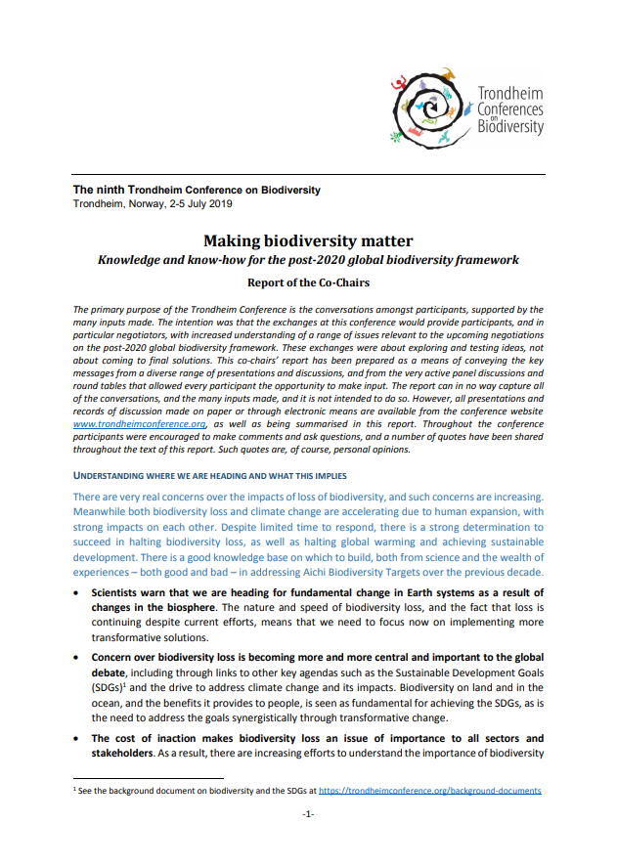
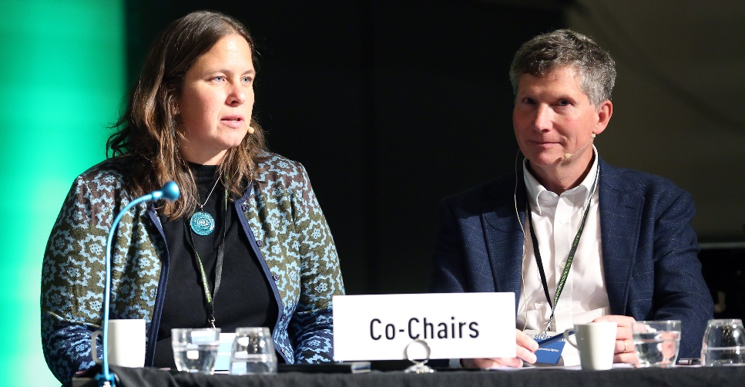
Conference reporting
Conference outcomes are set out in the report of the co-chairs, Dr. Nina Vik and Mr. Finn Katerås
Notes:
Conference outcomes are set out in the report of the co-chairs, Dr. Nina Vik and Mr. Finn Katerås, who are both my colleagues in the Norwegian Environment Agency.
In co-operation with the co-chairs I have presented what we believe are the most important contents for OEWG-1, but there are also many others I could have mentioned.
The full report is available as an information document for OEWG-1, and on our conference web site.
The report was prepared with support from a ‘Friends of the Co-Chairs’ group and offered to participants for review.
Additional outputs from the interactive sessions is available on our home page (https://trondheimconference.org/outputs-from-interactive-sessions-and-elements)

Slide 20
Making biodiversity matter
Over four days, a broad range of views were expressed on form and content of the post-2020 global biodiversity framework
Participants had opportunities to share knowledge and views outside of the negotiations
Overall message – Urgent action is required for many reasons; success is possible, but action to date has been insufficient
The post-2020 global biodiversity framework must promote and facilitate a step change in action on the ground
The conference produced a wealth of ideas included in the report, and in particular in the annexes
Notes:
To summarise:
Hvis dårlig tid, bare trekke fram punkt 3?

Slide 21
Conference website: https://trondheimconference.org/
Co-chairs’ report: https://trondheimconference.org/conference-reports
IISD/ENB coverage: https://enb.iisd.org/biodiv/trondheimconference/9/
Photos by IISD/ENB | Mike Muzurakis
Notes:
More information available on our conference home page, including co-chairs’ report, presentations and background documents.
In case someone asks the question on what was the second interactive session:
The second interactive session focused on lessons learned of actions, tactics and approaches for pathways to achieve the 2050 Vision
Seeking to draw on experience of participants, in order to learn about what works and what does not
This session was run as an ‘open space agenda’ – participants themselves identified the experiences that they wanted to discuss
Participants ‘followed their feet’ to join the conversations that they felt they could contribute to best
Outcomes of conversations – Annex 4 of the report
Probably more relevant for OEWG-2, and we may be coming to this.

