Slide 1
Indigenous peoples and local communities in the work of the Convention and its Protocols How can IPLCs transform CBD implementation towards the 2050 vision of living in harmony with nature? Lessons from Local Biodiversity Outlooks (LBO)
Joji Carino
Forest Peoples Programme

Slide 2
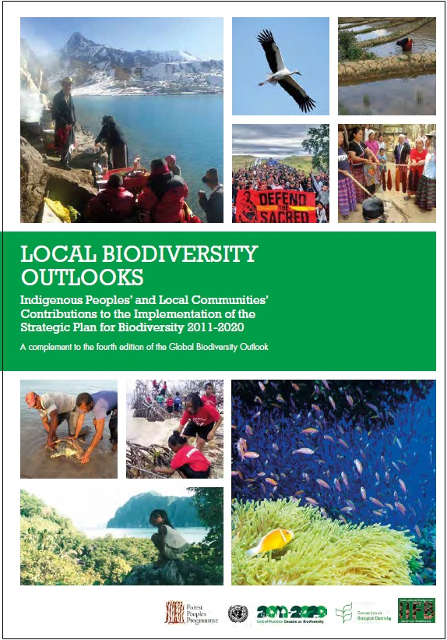
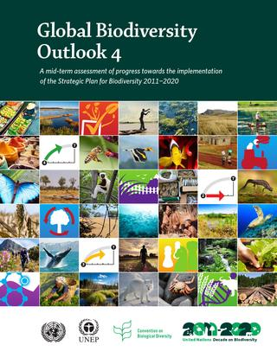
Notes:
An effort was made by indigenous peoples and local communities participating in the CBD to showcase our contributions to the implementation of the Strategic Plan for Biodiversity (2011-2020) in Local Biodiversity Outlooks, as a complement to Global Biodiversity Outlook and Regional Biodiversity Outlooks. This was launched at COP13 in Mexico and LBO Online was launched at COP14 in Egypt. This was an joint effort by the Indigenous International Forum on Biodiversity, the Forest Peoples Programme and supported by the Secretariat of the CBD.
A second edition of Local Biodiversity Outlooks will be launched alongside GBO5.

Slide 3
Key Findings from LBO
Collective actions of indigenous peoples and local communities (IPLCs) are advancing the Strategic Plan for Biodiversity and all 20 Aichi Biodiversity Targets
Traditional knowledge is cross-cutting and enabling of all targets
IPLCs’ lands hold much of the world’s biodiversity; supporting their actions can be one of the most effective ways to secure biodiversity conservation, sustainable use and sharing of benefits
Indigenous Peoples and Local Communities and are permanent partners of the Convention
Biological diversity and cultural diversity together increase resilience to social, environmental and climate changes.
Mainstreaming across global change agenda and society
Notes:
Examination of national reporting shows that Parties currently address Target in a narrow way, rather than as a cross-cutting and enabling of all Aichi Biodiversity Targets
The language of “stakeholders” is inadequate to describe the relationship of indigenous peoples and local communities as custodians and manager of lands, waters and biodiversity. We are rights-holders and partners in our countries and in the implementation of international commitments.
Cultural diversity, which is human intelligence must work with biological diversity which is nature’s intelligence, if we are to live in harmony with nature by 2050 - addressing our social, cultural and spiritual values
A shift of mindset is required in articulating the interwoven threads between nature and culture in the Anthropocene, and understanding our world as integrated social and ecological systems.

Slide 4
Key Findings from LBO
Policy commitments on traditional knowledge and customary sustainable use must be translated into programmes and projects in partnerships with IPLCs.
Importance of Partnerships from policy to implementation
Recognising customary land tenure and traditional occupations, and protecting human rights secure social wellbeing and ecosystem and climate benefits.
Measures are needed to counter the rise in assassinations of environmental and human rights defenders.
Consistency with international human rights obligations and UNDRIP
Community-based mapping and monitoring complement wider data and reporting systems and promote accountability for social, biodiversity, development and climate commitments.
Evidence base and monitoring through Local Biodiversity Outlooks
Notes:
Putting people at the centre of biodiversity and climate actions means applying a human rights based approach. The world of environmental agreements are not exempt or insulated from the fundamental United Nations approach to development.
Community-based mapping and monitoring is a critical part of the “ecosystem of data and information” complementary of satellite-derived information and to national statistics. Ground-truthing of biodiversity data and information is crucial.

Slide 5
What are the contributions of IPLCs to the achievement of the Sustainable Development Goals?
92% of SDG Targets are directly linked to human rights and require monitoring based on disaggregated data on status of those being “left behind”
Indigenous Peoples are undertaking community-based monitoring of implementation of UNDRIP, CBD Strategic Plan, SDGs and Paris CC commitments
Tools – Indigenous Navigator
Community information systems – websites, databases
Ensure monitoring of SDG indicator on secure customary and collective land tenure of indigenous peoples and the practice of traditional occupations as a cross-cutting elements under Goal 1- Ending Poverty; Goal 2 – Ending Hunger and Goal 5 – Gender Equality and Empowerment of Women and Girls
Notes:
Indigenous Peoples are coordinating our efforts across the biodiversity, climate change and sustainable development.

Slide 6
Virtuous Circles: Post-2020 Biodiversity Framework and Implementation
Harmonisation of Global Commitments
National and Local Implementation
MAINSTREAMING
Cultural and Biological Diversity Inter-linkages
NATURE-BASED AND CULTURE-BASED SOLUTIONS
Diverse Knowledge Systems
MULTI LEVEL LEARNING PLATFORMS:
SCIENCE AND ILK
Traditional Knowledge, Innovations and Practices
POLICY TO IMPLEMENTATION
Diverse Values, Institutions and Levels of Governance
CBD PERMANENT BODY
Notes:
Importance of Holistic and Integrated and Diverse Approaches:
Complex and integrated Social and Ecological Systems
Inter-linkages between biological and cultural diversity
Diverse ecosystems, economies and sustainable use practices
Nature-based and culture-based solutions
Legal pluralism responsive to diverse values, institutions and governance
Harmonisation of global agenda , national commitments ans

